Slide 1
Managing Information Technology Resources ITWS 4310
Project Management
September 17, 2018

Slide 2
Managing IT Resources Class Outline: Mon, Sept 17, 2018
Gamma Nu Eta Company Expose Invitation
Collin Jones
Term Projects
Submit Team Project Draft CBA by 9 PM tonight Sept 17
Quiz on today’s readings (current events & project management) and CBA
Constitution Day!
Current Events
Project Management Lecture and Discussion

Slide 3
Managing IT Resources Class Outline: Mon, Sept 17, 2018
Gamma Nu Eta Company Expose Invitation
Collin Jones

Slide 4
Managing IT Resources: ITWS 4310 Term Project Report Outline
Section 1: Executive Summary
Section 2: Introduction
Section 3: Client Organization and Description
Section 4: Project Team
Section 5: Problem Statement
Section 6: IS/IT Solution
Section 7: Methodology
Section 8: IS/IT Requirements
Section 9: IS/IT Design
Section 10: Cost-Benefit Analysis
Section 11: Project Plan/Schedule/Resources
Section 12: Post-Turnover Plan
Section 13: Results and Client Feedback
Section 14: Conclusions
Project Proposal:
Complete unless re-submit required (9pm tonight, Sept 17)
Cost-Benefit Analysis
due Sept 17 by 9 PM
Project Plan
due Sept 25 by 9 PM

Slide 5
Assignment: Draft Cost Benefit Analysis for your Term Project
Estimate the Costs by year for 5 years
Consider all fixed costs
Consider all variable costs
Consider all one time capital costs
Consider and place a value on Intangible Costs
Estimate the Benefits by year for 5 years
Consider all Changes to Revenues
Consider impacts on labor costs
Consider impacts on material and contract costs
Consider and place value on Intangible Benefits
Calculate the Net Present Value of Costs and Benefits
Calculate the Internal Rate of Return of the Project
Submit “Cost-Benefit Analysis” – NPV and IRR for 5 Years

Slide 6
General Cost Benefit Analysis Format for Term Projects
 | 2018 (Yr 0) | 2019 (Yr 1) | 2020 (Yr 2) | 2021 (Yr 3) | 2022 (Yr 4) | Total
Costs
Total Costs
Benefits
Total Benefits
Total Savings
Interest Rate: Net Present Value: Internal Rate of Return:

Slide 7
Quiz!

Slide 8
Constitution Day September 17, 2018

Slide 9
Constitution Day September 17, 2018
The US Constitution
Supreme law of the United States
Written during the Philadelphia Conference between May 1787 and September 17th 1787 (now known as the Constitutional Convention)
Replaced the Articles of Confederation
All of the States would not agree on ratification until Bill of Rights (providing for Individual Rights) was included
1st 10 amendments
Has been amended 27/~11,000 times
(18th and 21st)?
Notes:
18th – Prohibition
21st – Repeal of Prohibition

Slide 10
Constitution Day
The US Constitution & Bill of Rights
Constitution: Provided the framework for the US government
7 Articles, each outlines…
The Legislative Branch
The Executive Branch
The Judicial Branch
States Powers
Amendments (How-To)
The Supremacy Clause
Ratification
Bill of Rights: Provided for Individual Rights
Right to Freedom of Speech, Press, Assembly, Religion, & Petition (1st Amendment)
Right to Bear Arms (2nd Amendment)
Right to Speedy (6th) Trial by Jury (7th)
Subsequent Amendments: Provided (mostly) for Civil Rights
End of Slavery (13th & 14th Amendments)
Income tax (16th Amendment)
Right to vote for Women (19th Amendment)
Term Limits for president (22nd)

Slide 11

Constitution Day
http://www.constitutionday.com/index.html

Slide 12
Technology Current Events: “Apple's $1,000 iPhones are turning it into a luxury brand — and it could lose a whole generation of customers”, Business Insider, Sept 16, 2018. https://www.businessinsider.com/apple-iphone-xs-and-xr-mainstream-consumers-2018-9
Apple is increasingly transforming itself into a luxury brand. A year after debuting its first thousand-dollar smartphone, the company replaced it with two more.
At the same time, it cut its lowest-priced iPhone.
The moves could boost Apple's near-term revenue and profits.
But they could lead to stagnating phone sales and could discourage people from becoming Apple customers, which could have long-term consequences for the company.
Apple, it seems, has now fully bought into the notion that it's an upscale brand.
Its move this week to revamp its device lineup by doubling down on thousand-dollar phones, and simultaneously dropping its least expensive model, made clear that it's no longer overly concerned with appealing to customers of more limited means. Instead, the iPhone maker seems to believe that the way forward is to be the Louis Vuitton of consumer electronics.
That focus on the high-end has already started to pay off for the company in the form of near-term profits, even as it recently surged past a trillion-dollar market cap. But it could prove to be a bad bet in the longer term, particularly if it means that fewer consumers turn to Apple to purchase their first phone or other device.
But for years, particularly under former CEO Steve Jobs, the company made an effort to appeal to more mainstream consumers. When the iPod was its primary product, Apple offered models such as the Shuffle and the Nano, that had prices that put them within reach of average consumers. The iPad's $500 price was considered a bargain when it first launched. And when Apple has introduced new iPhone models, it has consistently discounted older ones, making them more accessible to a wider range of consumers.

Slide 13
Technology Current Events: “Kuo: Apple Watch Series 4 Pre-Orders Above Expectations, iPhone XS Seeing Lackluster Demand”, MacRumors, Sept 16, 2018. https://www.macrumors.com/2018/09/16/kuo-on-sept-2018-pre-orders/
Kuo says Apple Watch Series 4 pre-orders have been "better than expected," as a result of new innovative functions, such as electrocardiogram support. He predicts Apple Watch shipments will reach 18 million units in 2018, with the Series 4 lineup accounting for 50 to 55 percent of those orders. If the ECG support expands to more countries, Kuo believes the Series 4 lineup could see even stronger shipment momentum. In contrast, Kuo says iPhone XS pre-orders are "lower-than-expected," as customers opt for the iPhone XS Max or wait for the iPhone XR. Kuo has lowered his forecast for iPhone XS orders, believing the model will account for only 10 to 15 percent of shipments of the new 2018 iPhones, down from 15 to 20 percent.
Kuo says iPhone XS Max pre-orders have been in line with expectations, signifying the success of Apple's high-pricing strategy:
“There is strong Chinese demand thanks to the gold casing, dual-SIM, and large display. The XS Max average shipping time is shorter than the 2H17 iPhone X (1–2 weeks vs. 2–3 weeks), which we think is due to supply improvements. We maintain our forecasts that the XS Max will account for 25–30% of 2H18 new iPhone model shipments.”
Kuo sees a positive outlook for the iPhone XR, available to pre-order October 19, given its lower pricing and dual-SIM support in China. The well-known analyst increased his forecast for iPhone XR orders, estimating that the model will account for 55 to 60 percent of shipments of the new 2018 iPhones, up from 50 to 55 percent previously.

Slide 14
Technology Current Events: “Amazon probing employees leaking data for bribes”, CNET, Sept 16, 2018. https://www.cnet.com/news/amazon-reportedly-probing-employees-leaking-data-for-bribes/
Amazon is investigating reports of employees leaking confidential internal data and offering other services to sellers on its e-commerce platform in exchange for bribes, the Wall Street Journal reported Sunday.
Employees at the internet retailer are allegedly selling sales and search information to independent merchants selling products on the site, giving them an edge over competitors in violation of company policy, the newspaper reported. Brokers working as intermediaries for Amazon employees are also offering to delete negative reviews and restore banned accounts, the newspaper said, citing anonymous sellers, brokers and others familiar with the probe.
The investigation began in May after the company was tipped off to the practice taking place in China, where it's said to be most prevalent, the Journal reported.
The reports of bribery are the latest challenge Amazon faces in protecting the integrity of its marketplace after working for years to eradicate its sites of fake reviews and counterfeit products. Since 2015, the company has been filing legal actions to fight against scams and already sued more than 1,000 entities involved in allegedly creating fake product reviews on its sites.
Middlemen working for sellers in China who want negative reviews of their products deleted use the messaging service WeChat to identify and approach Amazon employees who want to perform the service in exchange for cash payments from around $80 to more than $2,000, the newspaper reported.
Amazon confirmed the investigation's existence Sunday afternoon.
"We hold our employees to a high ethical standard and anyone in violation of our Code faces discipline, including termination and potential legal and criminal penalties," Amazon said in a statement. "In addition, we have zero tolerance for abuse of our systems and if we find bad actors who have engaged in this behavior, we will take swift action against them, including terminating their selling accounts, deleting reviews, withholding funds, and taking legal action."

Slide 15
Technology Current Events: “The 2008 crisis really did start off worse than the Great Depression”, The Washington Post, Sept 15, 2018. https://www.washingtonpost.com/business/2018/09/15/crisis-really-did-start-off-worse-than-great-depression/?noredirect=on&utm_term=.4bfda900abc3
Ten years ago, we were hit by the biggest financial shock in world history, worse even than the Great Depression.
Indeed, during the 1930s, “only” a third of U.S. banks failed, while in 2008, former Federal Reserve chairman Ben S. Bernanke has said, 12 of the country’s 13 largest financial institutions were on the verge of going under when they were bailed out. A big part of the reason things were potentially so much more apocalyptic this time around was that we’d made it easier for bank runs to happen. It used to be that banks just borrowed money from depositors to then lend out themselves, which meant that any kind of panic required people to individually pull their money out. Now, though, many banks borrowed money from markets instead, so they could all go out of business overnight if those broke down — which they did.
So if nothing had been done, almost every major bank would have collapsed, and otherwise solvent companies wouldn’t have been able to borrow the money they needed to meet payrolls or manage the rest of their day-to-day operations. The Fed, then, would have had to go from being the lender of last resort to the lender of only resort — replacing these parts of the financial system itself — just so that we could have continued to have an economy. As it was, simply flirting with this possibility was enough to send the world economy into a free fall.
The painful lesson we’ve learned is that it’s impossible to do too much when you’re facing a Great Depression, but that it’s all too easy to do too little.

Slide 16
Project Management
What is a Project/Project Management
Project Life Cycle
Systems Development Life Cycle
Project Planning: Scope and Work Breakdown Structure (WBS)
Project Planning: Schedule and Budget
Project Portfolio Management

Slide 17
What is a Project?
The Project Management Institute defines a project as:
“a temporary endeavor undertaken to create a unique product, service or result.”
A project is temporary in that it has a defined beginning and end in time, and therefore defined scope and resources.
A project is unique in that it is not a routine operation, but a specific set of operations designed to accomplish a singular goal.
Different from processes and operations:
No predetermined end
Repetitively produce same product or service
Notes:
https://www.pmi.org/about/learn-about-pmi/what-is-project-management

Slide 18
What is Project Management?
The Project Management Institute defines project management as:
“the application of knowledge, skills, tools, and techniques to project activities to meet the project requirements.”
In practice we often define as:
“the application of knowledge, skills, tools, and techniques to project activities to meet or exceed the project requirements stakeholder needs and expectations.”
Needs = identified requirements
Expectations = unidentified requirements
Notes:
https://www.pmi.org/about/learn-about-pmi/what-is-project-management

Slide 19
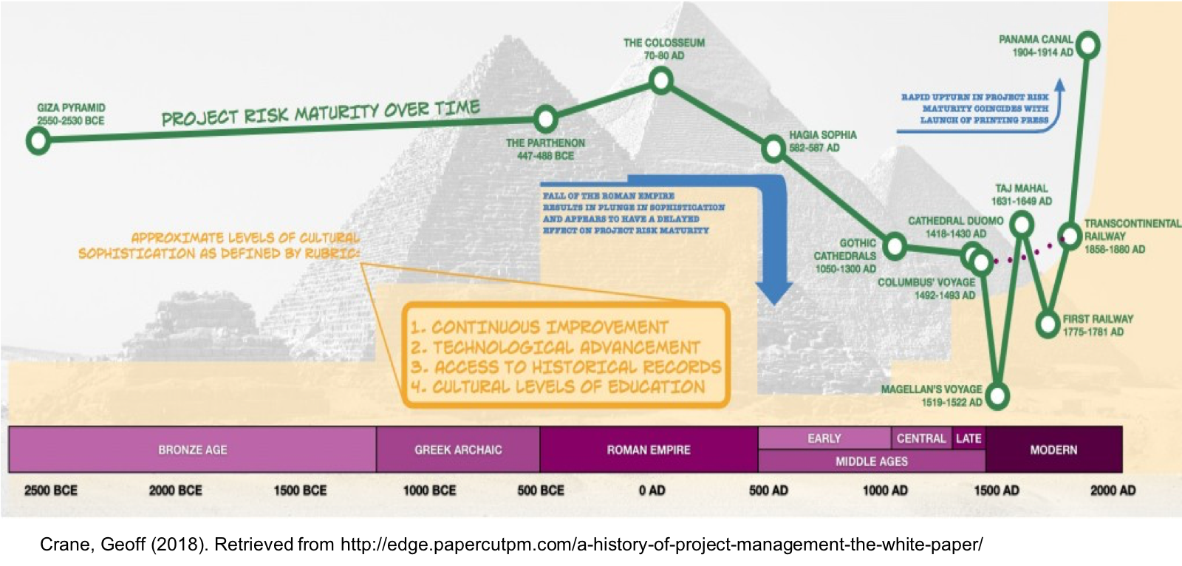
History of Project Management
Notes:
Ask students when they believe project management started

Slide 20
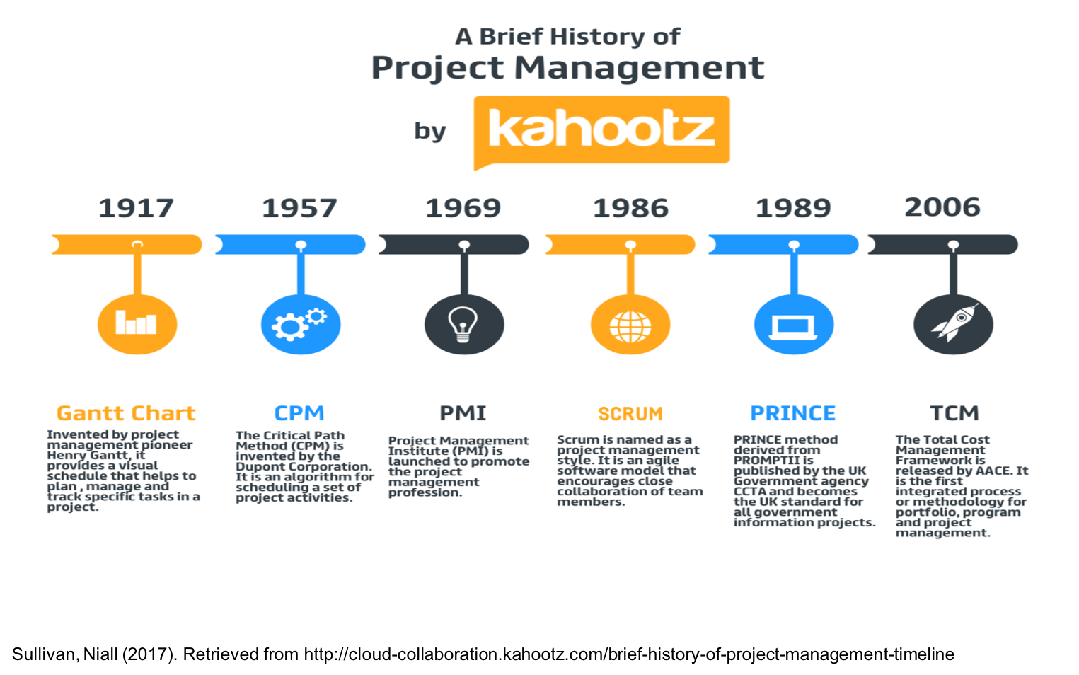
History of Project Management
1958: Recognized as the year “Modern Project Management” was born.

Slide 21
History of Project Management
Why 1958?
Beginning of the “giant project”
Projects where the size, complexity, time span, resource requirements, and costs demanded more than the Gantt chart could provide as the sole management tool/methodology.
Many papers published identifying this shift
Most recognized paper on the topic from 1958:
“On the Anatomy of a Development Project” by Peter Norden
Based upon his observations in computer development at IBM
Norden identified “there was indeed a difference between ordinary production type work and something which was clearly becoming identified as project type work.”
Notes:
https://www.pmi.org/learning/library/modern-project-management-disciplines-direction-1810

Slide 22
Project Management in Practice
A balance of science and art
Science
A prerequisite to practicing the art
Provides the foundation for the art of leadership
Includes theories, methods, and techniques to manage the complexities of projects
Art
“The soft skills”
Includes politics, intuition, interpersonal skills, decision making skills, etc.
Just as, if not more important than, the science

Slide 23
Project Management Methodologies
“How do we deliver a project?”
We use a methodology!
“But what is a methodology?”
According to PMI, a methodology is a system of practices, techniques, procedures and rules used by those who work in a discipline.
Using a methodology provides structure to the way a project is delivered – “we apply different themes, frameworks, processes, etc. to ensure successful project completion”

Slide 24
Project Management Methodologies
Many, many options – we will cover a few of them shortly
Each has their advantages/disadvantages and it is up to the project manager to determine which should be used for which project
What is the “right” methodology?
Sometimes, the organization dictates the methodology to be used for a project
Can (or should) we use a combination of methodologies on a given project?
Can (or should) we use modified versions of a methodology on a given project?

Slide 25
The Project Life Cycle
Collection of logical stages or phases that
maps the life of a project
from its beginning, through its middle, to its end,
to define, build, and deliver the product.

Slide 26
A Generic Project Life Cycle

Slide 27
PMI/PMBOK “Method”
A project lifecycle has 5 phases, with many different activities occurring in each phase
Initiating
Processes
Planning
Processes
Controlling
Processes
Executing
Processes
Closing
Processes

Slide 28
PMI/PMBOK “Method”
The level of PM activity varies based on the phase
Project Life Cycle Phases
Initiating Processes
Planning Processes
Executing Processes
Controlling Processes
Closing Processes
Level of
Activity
Time

Slide 29
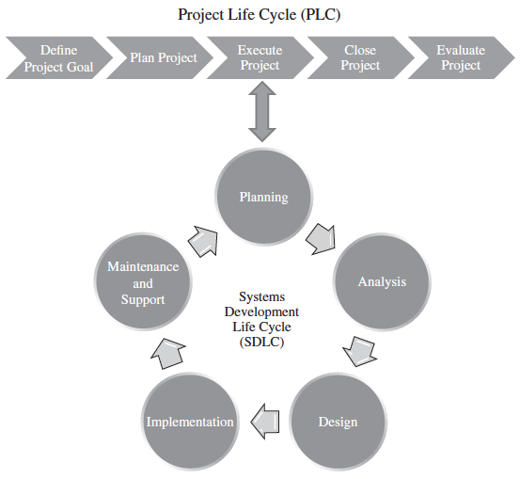
The Project Life Cycle (PLC) and the Systems Development Life Cycle (SDLC)

Slide 30
Implementing the SDLC
Defines all of the sub-phases and deliverables associated with the Execute and Control Project Management Life Cycle phase.
Number of Ways to implement the SDLC
Waterfall
Agile

Slide 31
Project Management Methodologies
“Traditional” or Sequential Methodologies
Waterfall
Critical Path Method (CPM)
Agile Methodologies
Scrum
Kanban
Critical Chain Project Management (CCPM)
Extreme Programming (XP)
Adaptive Project Framework (APF)
Change Management Methodologies
Event Chain Methodology (ECM)
Extreme Project Management (XPM)
Process-based Methodologies
Lean
Six Sigma
Lean Six Sigma
Other Methodologies
PRINCE2
PRiSM
Benefits Realization
PMI/ PMBOK “Method”
PMI/ PMBOK “Method”
Notes:
https://www.wrike.com/project-management-guide/methodologies/
https://thedigitalprojectmanager.com/project-management-methodologies-made-simple/

Slide 32
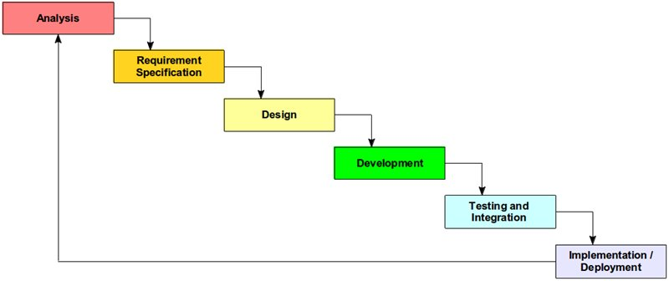
Traditional or “Sequential” Methodologies
Waterfall (“SDLC”)
Project tasks are planned in advanced and worked on in order – you do not move on to the next task until the previous is complete.
Gladkova, Ekaterina (2012). Retrieved from https://sysgears.com/articles/agile-vs-waterfall-development-model/
Notes:
https://www.wrike.com/blog/a-crash-course-in-project-management-methodologies-infographic/
https://sysgears.com/articles/agile-vs-waterfall-development-model/

Slide 33
Agile Methodologies
Agile was created in 2001
A group pf 17 people wrote down their agile philosophies: “Agile Manifesto of Software Development”
The four main values of agile:
Individuals and interactions over processes and tools
Working software over comprehensive documentation
Customer collaboration over contract negotiation
Responding to change over following a plan
Notes:
https://www.wrike.com/project-management-guide/methodologies/

Slide 34
Agile Methodologies
All agile methodologies share the same basic commonalities – all based on the 4 values laid out in the manifesto
The customer gives clear objectives but the final deliverable may change
The team works in iterations with each iteration ending with an evaluation of the results
Continuous collaboration is essential – between all team members and team members and customer
Notes:
https://www.wrike.com/project-management-guide/methodologies/

Slide 35
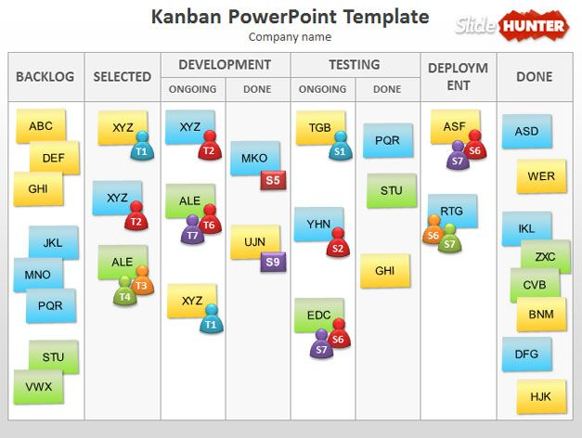
Agile Methodologies
Kanban
Retrieved from https://slidehunter.com/powerpoint-templates/kanban-powerpoint-template/
Notes:
https://slidehunter.com/powerpoint-templates/kanban-powerpoint-template/

Slide 36
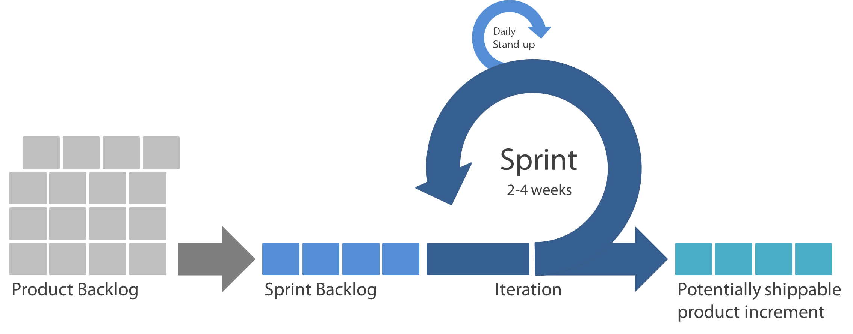
Agile Methodologies
Scrum
Productivity and collaboration are key as part of short sprints that are designed to produce high-quality deliverables while quickly adapting to changes
Muazekici (2016). Retrieved from https://github.com/bounswe/bounswe2016group6/wiki/Scrum:-A-new-perspective-on-agile-development
Notes:
https://www.wrike.com/blog/a-crash-course-in-project-management-methodologies-infographic/
https://github.com/bounswe/bounswe2016group6/wiki/Scrum:-A-new-perspective-on-agile-development

Slide 37
Project Planning: Scope and the Work Breakdown Structure

Slide 38
Introduction
Scope –
defines the work boundaries and deliverables of the project so what needs to get done, gets done – and only what needs to get done, gets done.
is determined directly by the project’s MOV.
Defines all the work, activities, and deliverables that the project team much provide for the project to achieve its MOV
Work Breakdown Structure – a project management tool that provides a hierarchical structure that acts as a bridge, or link, between the project’s scope and the detailed project plan that will be created.
Notes:
MOV = Measurable Organizational Value

Slide 39
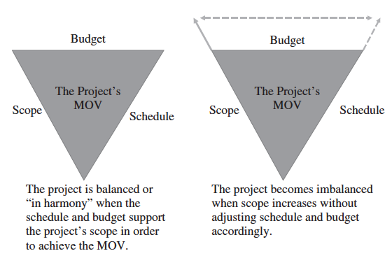
The Triple Constraint
Notes:
MOV – Projects overall goal and measure of success

Slide 40
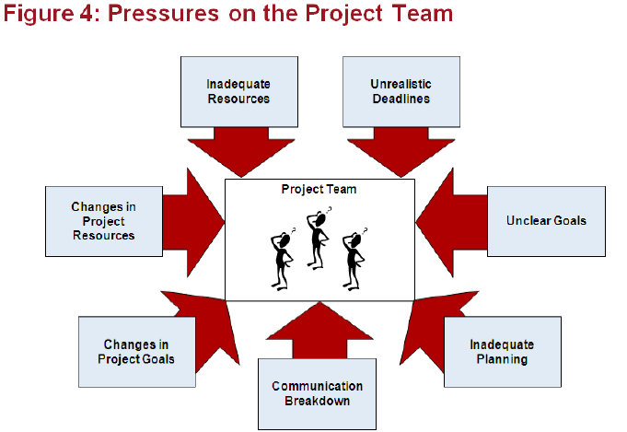
Project Challenges

Slide 41
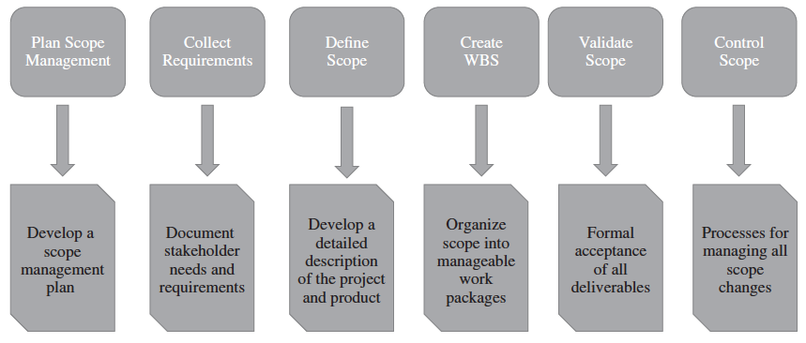
Scope Management Plan

Slide 42
Work Breakdown Structure (WBS)
The PMBOK® Guide states that the WBS represents a logical decomposition of the work to be performed and focuses on how the product, service, or result is naturally subdivided. It is an outline of what work is to be performed.

Slide 43
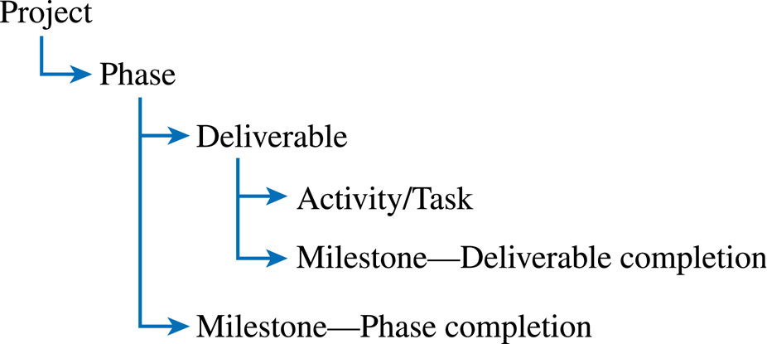
Work Package

Slide 44
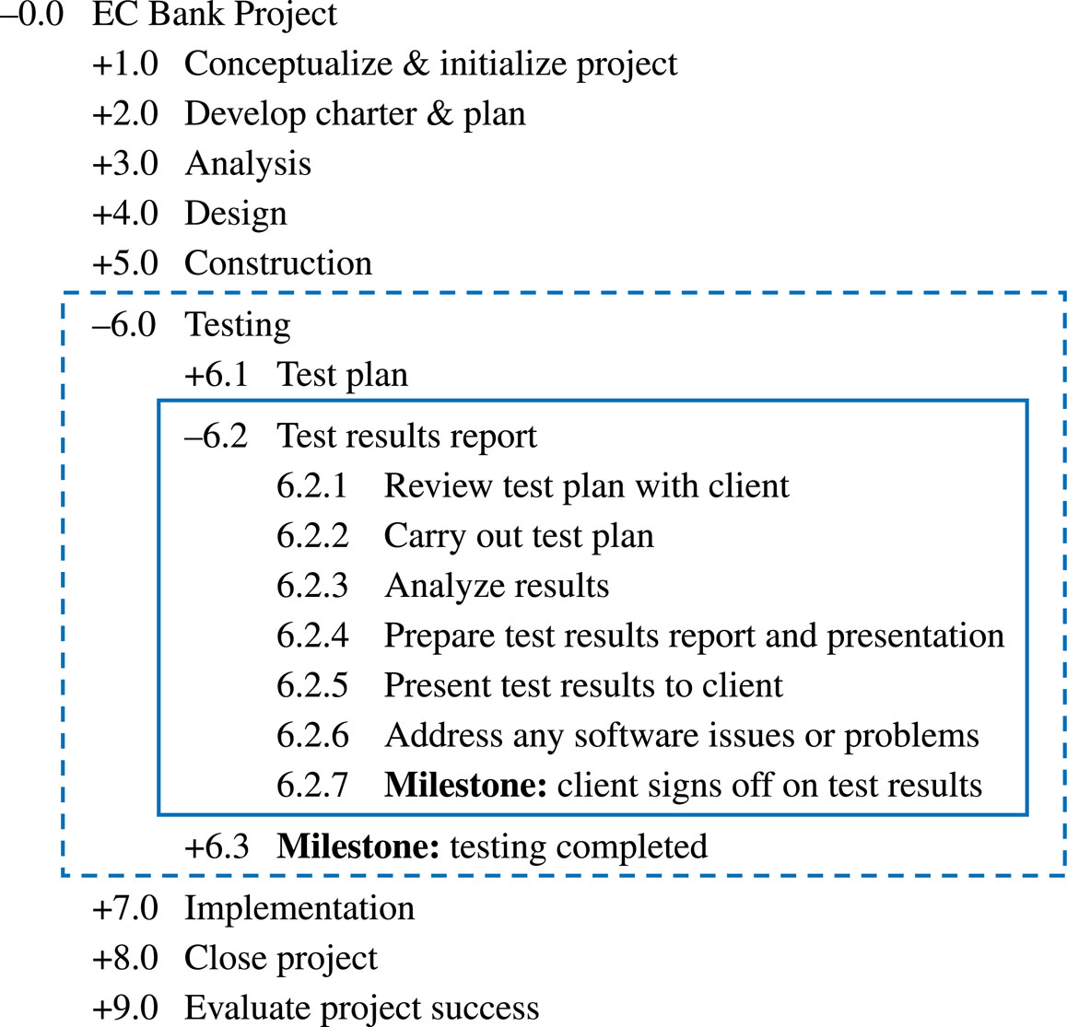
Example Work Breakdown Schedule

Slide 45
Project Planning: The Schedule and Budget

Slide 46
Schedule and Budget Development
The project’s schedule can be determined based upon the tasks and time estimates in the WBS
The schedule will also depend on how these activities are sequenced
The project’s budget can be determined based upon the activities and time estimates from the WBS as well as the cost of the resources assigned to the WBS tasks
Iterations may still be necessary
The objective is to create a realistic project schedule and budget

Slide 47
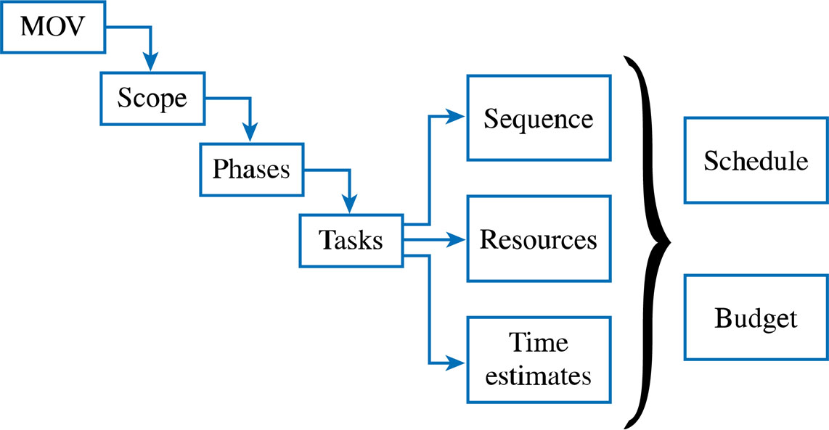
The Project Planning Framework

Slide 48
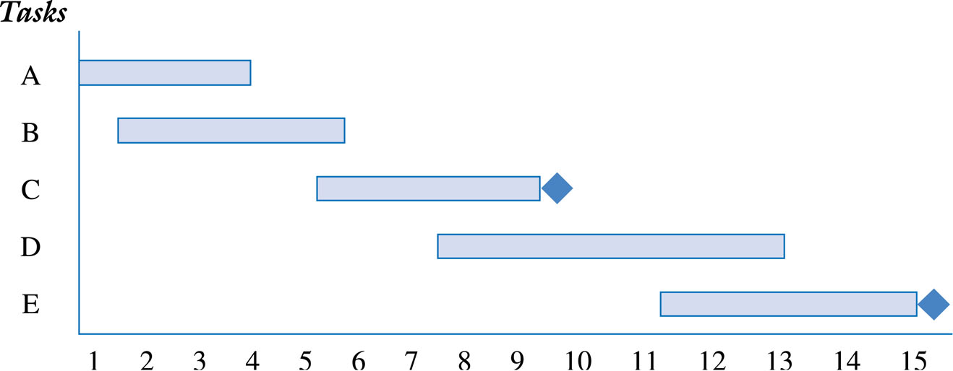
Gantt Chart for Planning

Slide 49
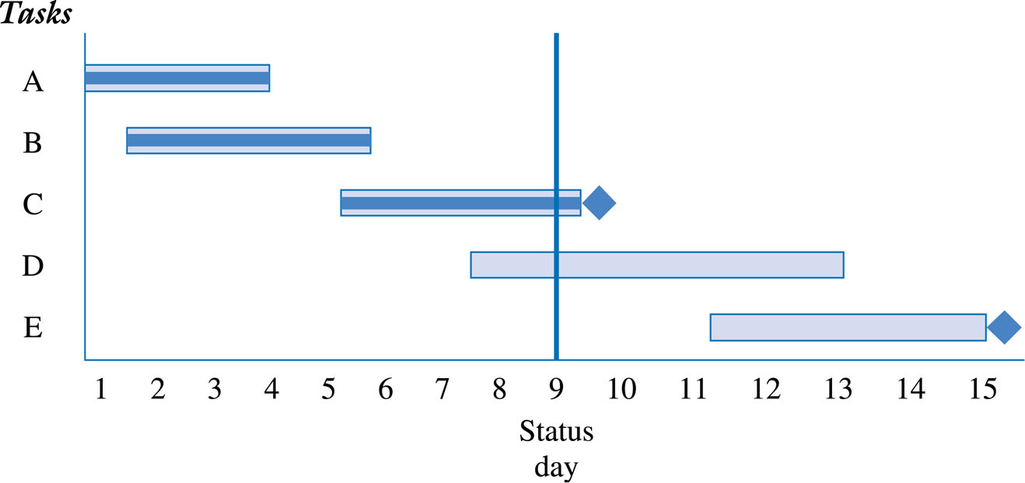
Gantt Chart Reporting Project’s Progress

Slide 50
Lead and Lag Times
Lead is starting the next task before the first task is complete
Example: Begin installing the operating systems when half of the PCs are set up
Lag (or negative lead) is the adding of a buffer of time before the next task begins
Example: Once the walls have been painted, wait one day before laying the carpet so that the walls have had a chance to dry

Slide 51
Project Management Software Tools
A number of project management software tools are available to plan and track the progress of your project
However, having a fundamental understanding of these project management techniques is important to make the most of these software tools

Slide 52
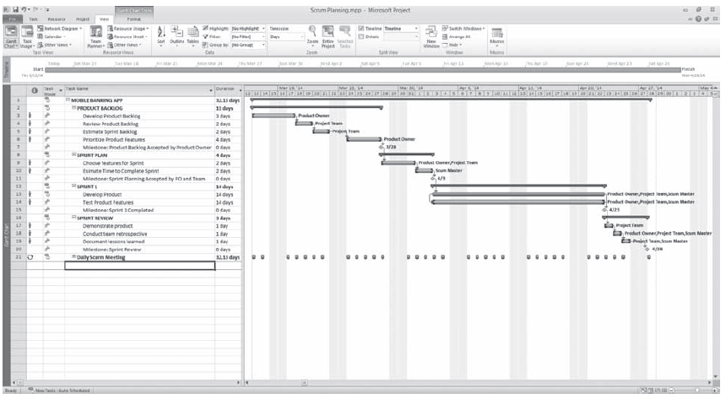
GANTT Chart in Microsoft Project ®

Slide 53
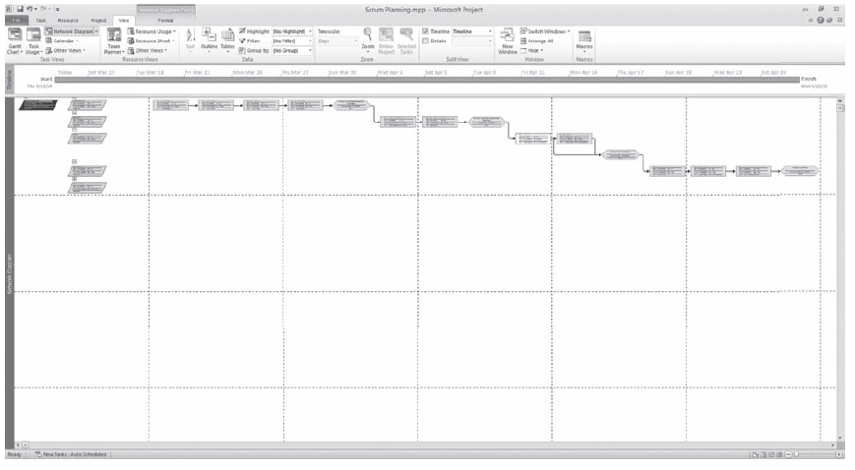
Network Diagram and Critical Path in Microsoft Project ®

Slide 54
Developing the Project Budget
Define what resources will be needed to perform the work
Determine the quantity of resources that are needed
Define the cost of using each resource
Calculate the cost of the task or activity
Ensure that the resources are leveled, that is, not over allocated. An example of over allocation is assigning a project team member to two tasks scheduled at the same time.

Slide 55
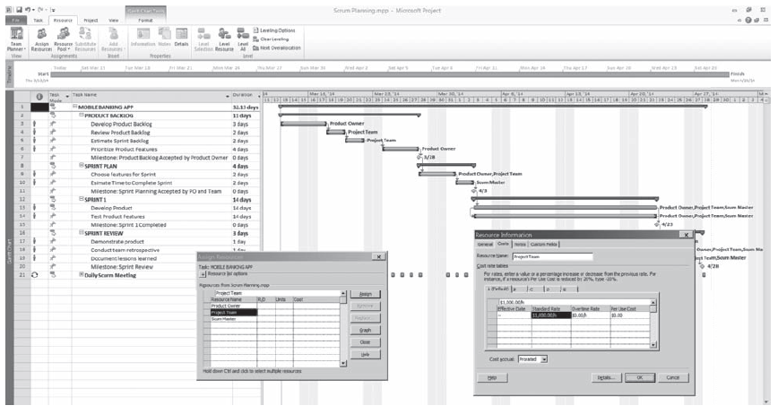
Project Resources Assigned to Project Tasks in Microsoft Project ®

Slide 56
What Creates a Successful Project?
Communication
Management support
Agreement on scope and deliverables at start of project
Effective adjustments if/when change occurs

Slide 57
What Makes a Good Project Manager?
A person who excels at both the science and art of project management
Someone who understands how to manage people who may, or may not, directly report to them
Functional vs. matrix team
An individual who understands how much project management is required for a project
Must add value by leading and not just managing
Too much is often as bad as not enough
The “Unsung Hero”
When a project goes well, the team members did it
When a project fails, it was the PMs fault

Slide 58
So, Who Wants to be a Project Manager?
CAPM – Certified Associate in Project Management
PMP – Project Management Professional
PgMP – Program Management Professional
PfMP – Portfolio Management Professional
PMI-PBA – PMI Professional in Business Analysis
PMI-ACP – PMI Agile Certified Practitioner
PMI-RMP – PMI Risk Management Professional
PMI-SP – PMI Scheduling Professional
https://www.pmi.org/certifications/types
Notes:
https://www.pmi.org/certifications/types

Slide 59
Project Portfolio Management
Generally, an organization is faced with more IT needs/opportunities than can be undertaken due to constraints:
Limited investment capital
Limited human resources
Ability to Focus
Need to decide which projects to pursue
Need to manage the portfolio of projects

Slide 60
Tjan’s Applications Portfolio Strategy
Viability
High
Sell, Spin Off
Invest
Kill
Redesign
Low
Low High Fit

Slide 61
Gantter.com In-Class Exercise – Thursday’s Class
Get access to the free Cloud Based Project Application Tool, Gantter, at www.gantter.com
Choose the Gantter edition that is best for you from http://gantter.com/gantter-editions/ . I use the Gantter for Google Apps edition.
Research how to use Gantter via their website and or YouTube videos
Be prepared to do the In-Class Exercise using Gantter.

Slide 62
Managing IT Resources Week 4 Assignments – Sept 17 - 20
Work with Client on Planning the Team Project especially on the “Requirements”, “Schedule”, and ”CBA”
Submit the Team Project Draft “Cost-Benefit Analysis” by 9 PM tonight Sept 17
Read the Current Events articles posted on LMS prior to Class on Sept 20
Be prepared to take Quiz on current events and material from today’s class at beginning of Class on Sept 20
Be prepared to do In-Class Exercise on Project Management on Sept 20
Each Student submit In-Class Exercise on Project Management by 9 PM on Sept 23
Submit the Team Project Draft “Project Management Plan” by 9 PM on Sept 25

